Slide 1

Fire Fighting Robot
Innovative Solutions for Enhanced Fire Detection and Response
Presented By
KISHORE KUMAR S SELVAGANAPATHY R
SRIRAJ P
SIVAPRIYA V
SARUMATHI S
21 FEB 2026

Slide 2
EXISTING SYSTEMS
Current System Overview
Types: Ground-based robots (autonomous/semi-autonomous)
Key Features: Sensors (IR, thermal, gas), cameras, fire extinguishing units
Applications: Hazardous environments (factories, tunnels, etc.)
Control: Remote-controlled or basic AI navigation
Challenges / Limitations
Navigation Issues: Difficulty in smoke-filled or debris-heavy areas
Sensor Limitations: Impaired by heat, smoke, and low visibility
Limited Autonomy: Relies on human control in complex scenarios
Power Constraints: Short battery life and limited terrain capability
Communication Gaps: Signal loss in enclosed/fire-prone zones
High Costs: Expensive to build, maintain, and deploy

Slide 3
PROPOSED SYSTEM
🔍 Solution Overview:
An autonomous fire-fighting robot designed to detect, approach, and extinguish fires in hazardous environments, minimizing human risk and response time.
✨ Key Features:
Real-time fire and smoke detection using thermal and gas sensors
Autonomous navigation with obstacle avoidance
Onboard fire suppression system (e.g., CO₂ or water spray)
Remote control and live video feed for manual override
💡 Innovation:
Combines AI-powered fire source localization with smart mobility to operate effectively in unpredictable and high-risk indoor settings.

Slide 4
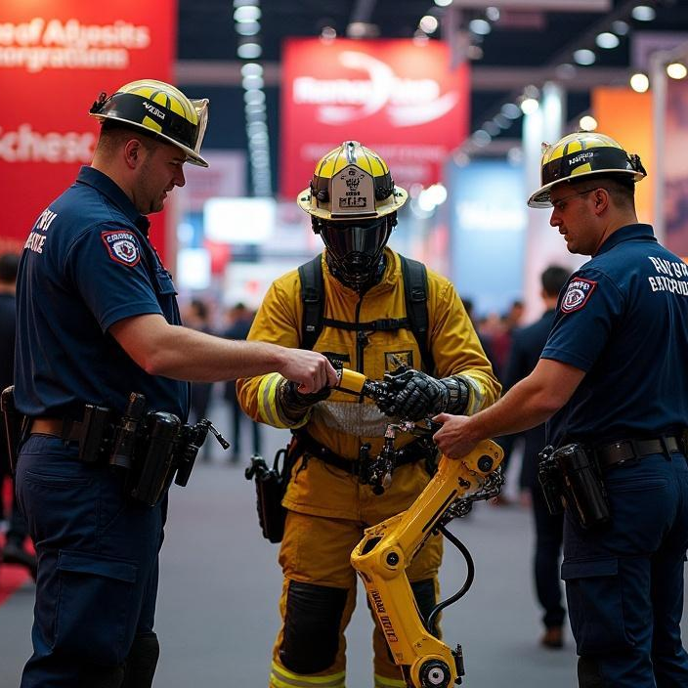
DIFFERENT WAYS OF MARKETING THE PROJECT
Social Media Campaigns
Demo videos on platforms like Instagram, YouTube, TikTok
LinkedIn for professional/tech audience
Live Demonstrations & Expos
Science fairs, tech expos, safety conferences
University or community events
Collaborations with Fire Departments
Partner for pilot tests and endorsements
Real-world footage for promotion
Crowdfunding Platforms
Kickstarter/Indiegogo for public support and funding
Engages early adopters and enthusiasts
Targeted Email Marketing
Reach out to safety equipment suppliers, municipalities, and investors
Press & Media Coverage
Local news, tech blogs, innovation columns
"Robot Revolutionizing Firefighting" angle
Website & SEO
A dedicated landing page with detailed info, videos, and contact form

Slide 5
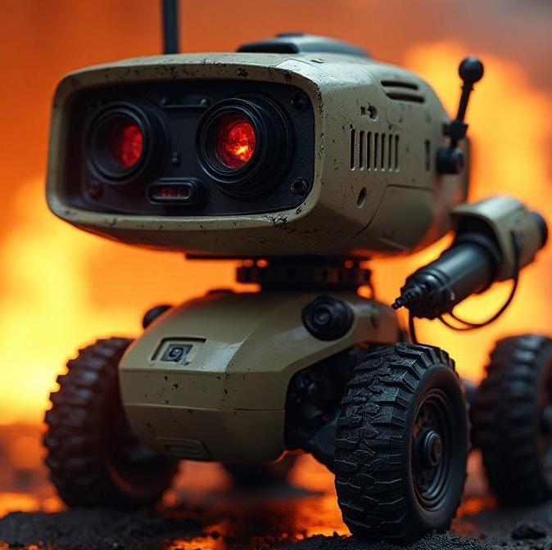
GENERAL BENEFITS OF PROJECT
Enhances Safety: Reduces risk to human firefighters in hazardous environments.
Access to Danger Zones: Reaches areas unsafe or inaccessible for people
Early Fire Response: Detects and suppresses fires quickly using sensors.
Operates Continuously: Functions without fatigue in extreme conditions.
Real-Time Monitoring: Sends live video and data for better decision-making
Cost-Effective Long-Term: Lowers injury, damage, and training costs over time.
High Precision: Targets fire accurately, minimizing water and property damage.

Slide 6
BUDGET FOR PROJECT
IR 4 pin Flame sensors x 3 =180
Arduino UNO = 2900
BO motors x 4 (+wheels) =150
L298 Motor driver =150
Solder-less Breadboard =100
Mini servo =70
5-9 V Water pump + pipe =100
Water tank / bottle =20
3.7 V batteries (18650) x 2 =180
Jumper wires =100
TIP-122 Transistor
104 pf capacitor
1K Resister
Glue gun =200
Soldering =200
=50

Slide 7
FEATURES
The Fire Fighting Robot represents a crucial advancement in automated emergency response.
By detecting and extinguishing fires autonomously, it reduces risk to human firefighters, accelerates response times, and improves safety in hazardous environments.
With further development, this technology can be integrated into smart buildings and disaster-prone areas, playing a key role in future fire management systems.

Slide 8
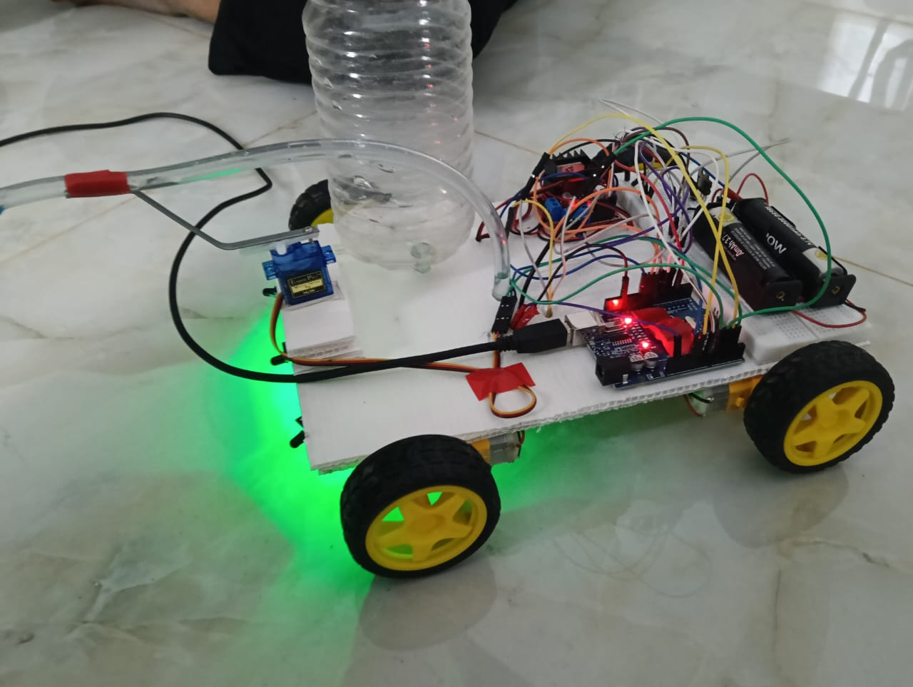
PROTOTYPE
Works by the alerting indication from the sensors and appear in that location to rescue the fire and make the public to feel safe until the next emergency conditions occurs.

